Slide 1
Secure Data Hiding in Image Using Steganography
CAPSTONE PROJECT
Presented By:
Student Name : Anshika Jaiswal
College Name & Department : United Institute of Technology

Slide 2
OUTLINE
Problem Statement
Technology used
Wow factor
End users
Result
Conclusion
Git-hub Link
Future scope

Slide 3
Problem Statement
Secure Data Hiding in Image Using Steganography : This project aims to develop a secure image steganography system that can embed confidential data within an image without significantly altering its appearance. The system should ensure high imperceptibility, robustness against attacks, and efficient data retrieval.

Slide 4
Technology used
Libraries:
import cv2
import os
import string

Slide 5
Wow factors
Require a password or a secret key to retrieve the hidden data, making it even more secure.

Slide 6
End users
Cybersecurity Professionals & Ethical Hackers
Journalists & Whistleblowers
Law Enforcement & Intelligence Agencies
Researchers & Academicians
Digital Forensics Experts
General Users & Privacy Enthusiasts

Slide 7
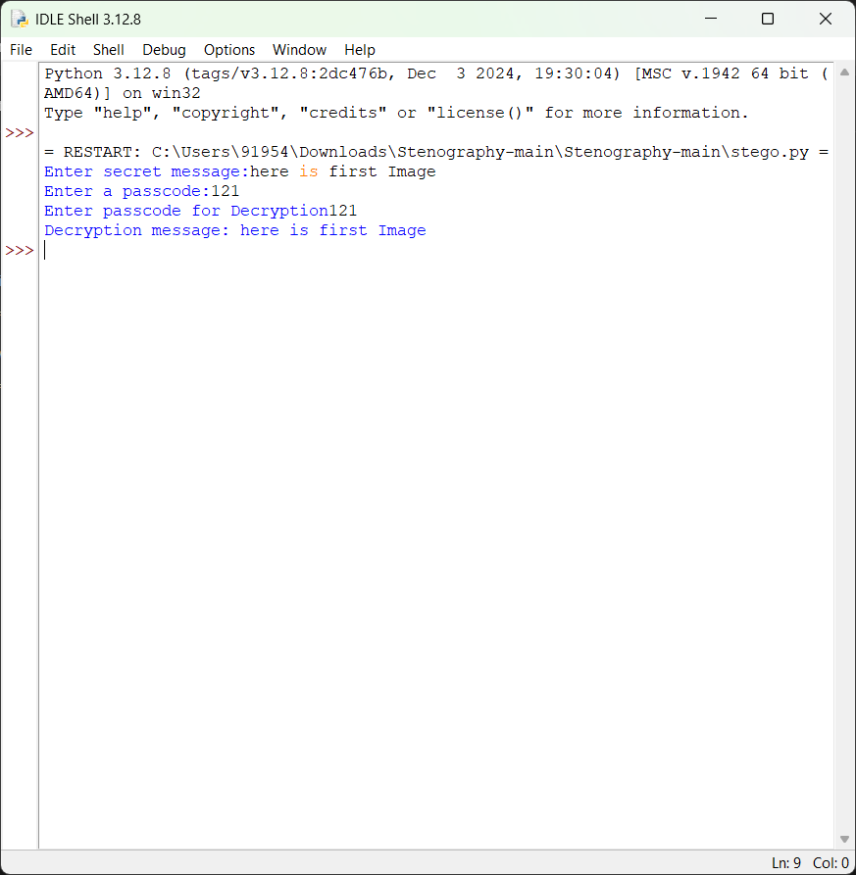
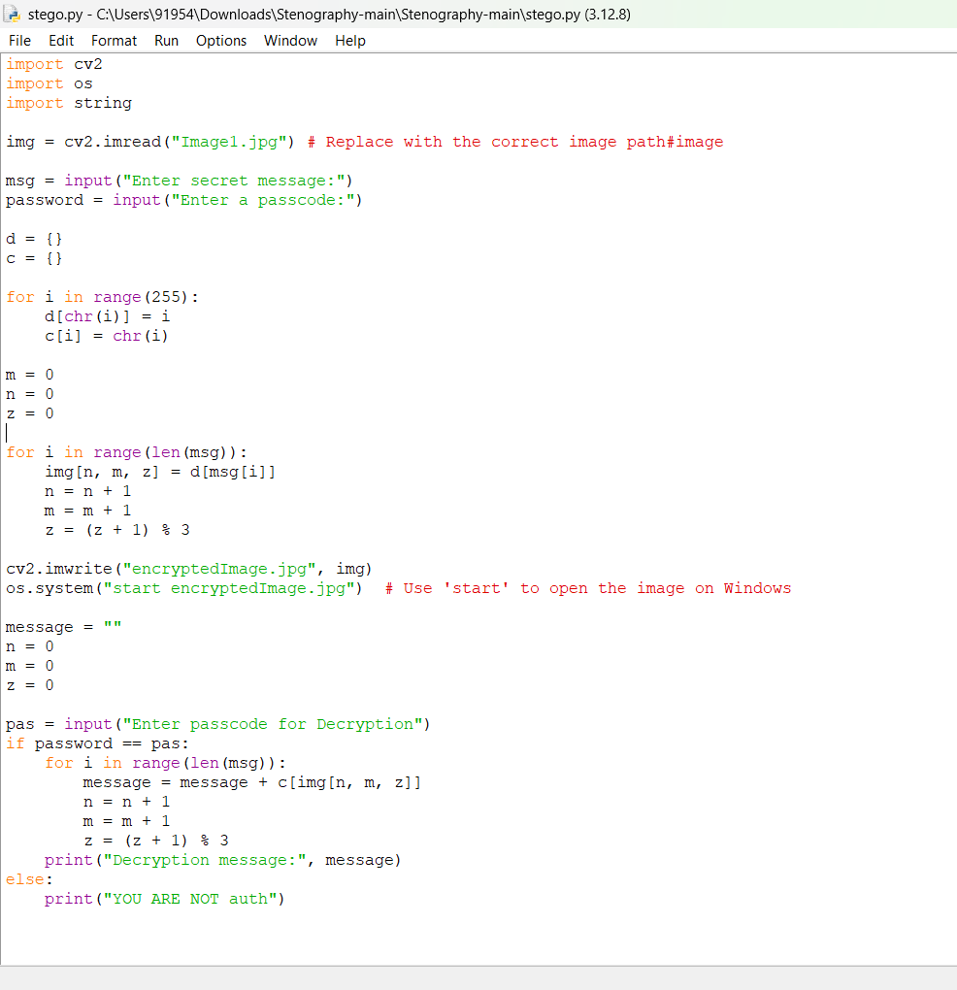

Results

Slide 8

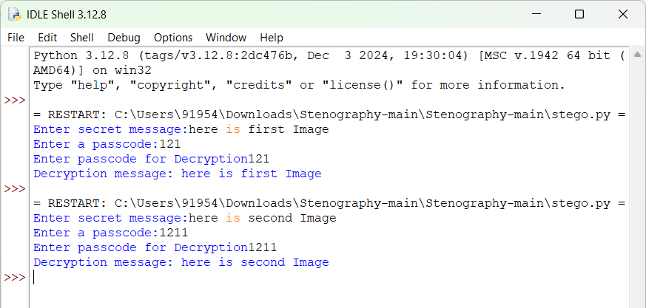

Slide 9
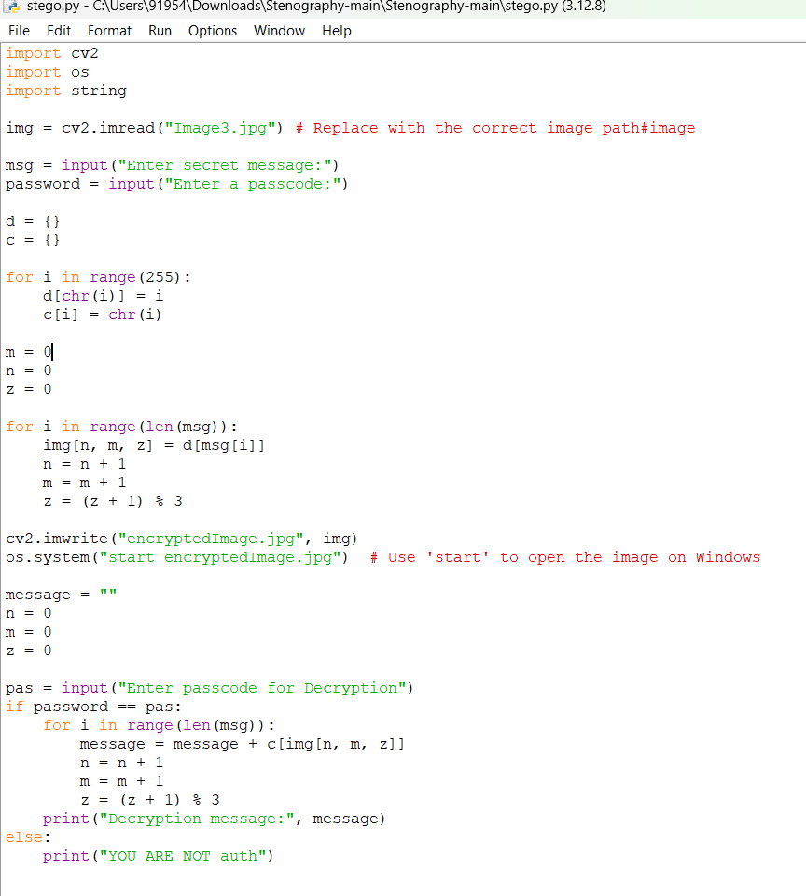
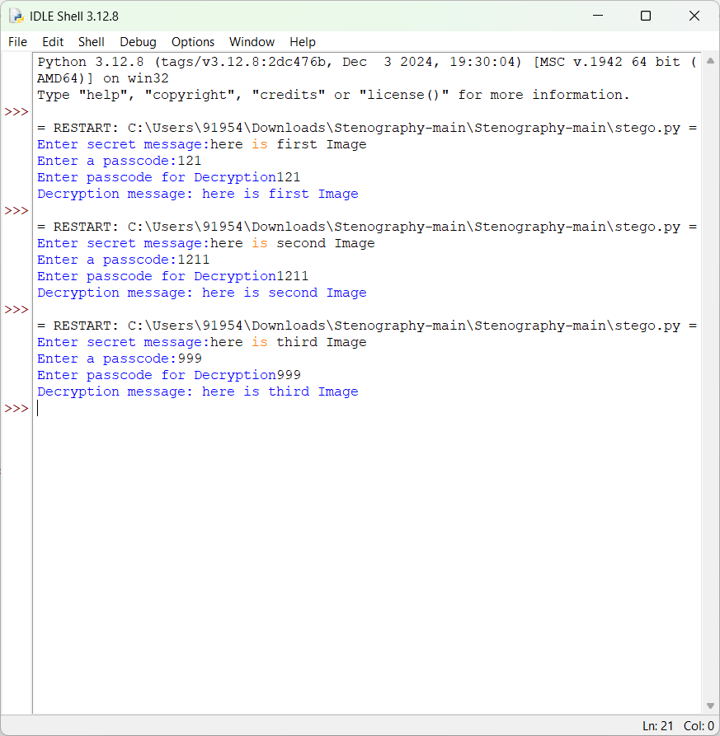

Slide 10
Conclusion
This project serves as a foundation for real-world applications in cybersecurity, forensics, and secure communication. With further enhancements, it can be transformed into a powerful tool for covert data transmission and digital privacy protection.

Slide 11
GitHub Link
https://github.com/Anshikaa459/my_project_1.git

Slide 12
This project has significant potential for future development and can be enhanced in various ways to improve security, usability, and real-world applications.
Future scope(optional)
Implementing machine learning algorithms to optimize message embedding locations.
Using deep learning techniques to enhance steganalysis resistance.
.

Slide 13
THANK YOU

